Slide 1
Introduction
Chapter 1

Slide 2
The Digital Computer
Machine to carry out instructions
  A program
Instructions are simple
  Add numbers
  Check if a number is zero
  Copy data between memory locations
Primitive instructions in machine language

Slide 3
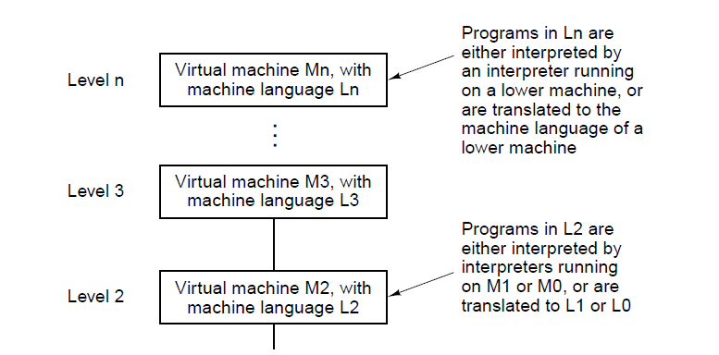
Languages, Levels, and Virtual Machines (1)
. . .
Figure 1-1. A multilevel machine.

Slide 4
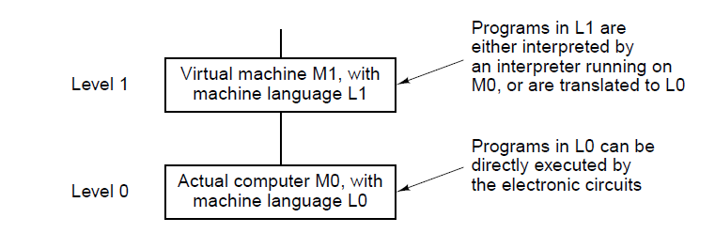
Languages, Levels, and Virtual Machines (2)
. . .
Figure 1-1. A multilevel machine.

Slide 5
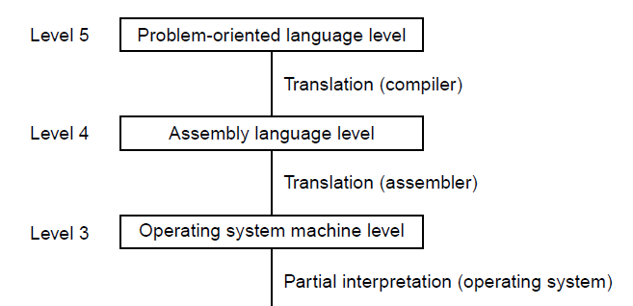
Contemporary Multilevel Machines (1)
. . .
Figure 1-2. A six-level computer. The support method for each level is indicated below it (along
with the name of the supporting program).

Slide 6
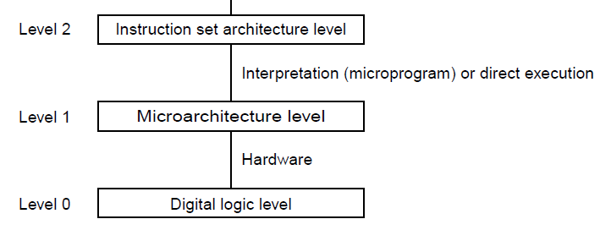
Contemporary Multilevel Machines (2)
. . .
Figure 1-2. A six-level computer. The support method for each level is indicated below it (along
with the name of the supporting program).

Slide 7
Evolution of Multilevel Machines
Invention of microprogramming
Invention of operating system
Migration of functionality to microcode
Elimination of microprogramming

Slide 8
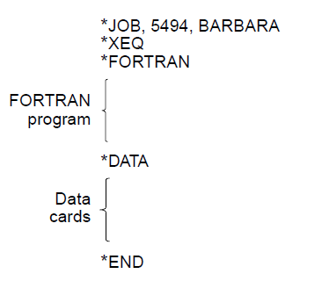
Operating System Tasks
Figure 1-3. A sample job for the FMS operating system.

Slide 9
Increased Functionality in Microcode (1)
Instructions for integer multiplication and division
Floating-point arithmetic instructions
Instructions for calling and returning from procedures
Instructions for speeding up looping
Instructions for handling character strings
Indexing and indirect addressing
Relocation facilities
Interrupt systems
Process switching
Processing audio, image, multimedia files

Slide 10
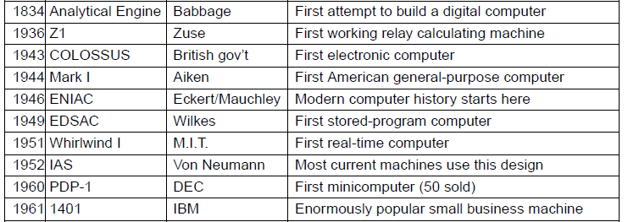
Milestones (1)
. . .
Figure 1-4. Some milestones in the development
of the modern digital computer.

Slide 11
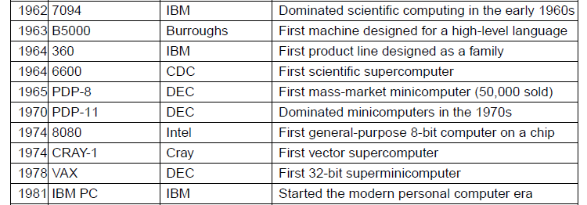
Milestones (2)
. . .
Figure 1-4. Some milestones in the development
of the modern digital computer.

Slide 12
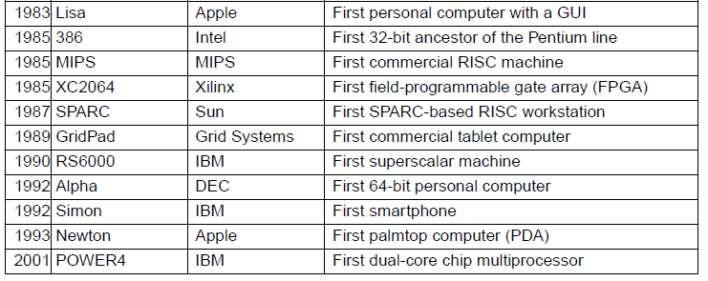
Milestones (3)
Figure 1-4. Some milestones in the development
of the modern digital computer.

Slide 13
Computer Generations
Zeroth Generation Mechanical Computers (1642 – 1945)
First Generation Vacuum Tubes (1945 – 1955)
Second Generation Transistors (1955 – 1965)
Third Generation Integrated Circuits (1965 – 1980)
Fourth Generation Very Large Scale Integration (1980 – ?)
Fifth Generation Low-Power and Invisible Computers

Slide 14
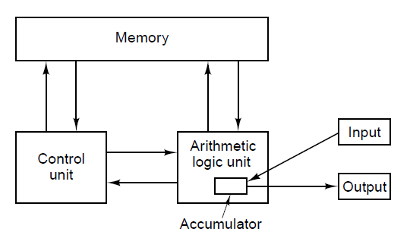
von Neumann Machine
Figure 1-5. The original von Neumann machine.

Slide 15
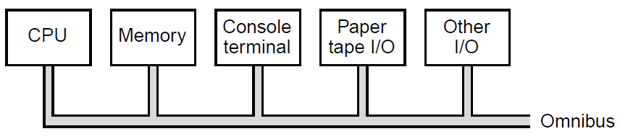
PDP-8 Innovation – Single Bus
Figure 1-6. The PDP-8 omnibus.

Slide 16
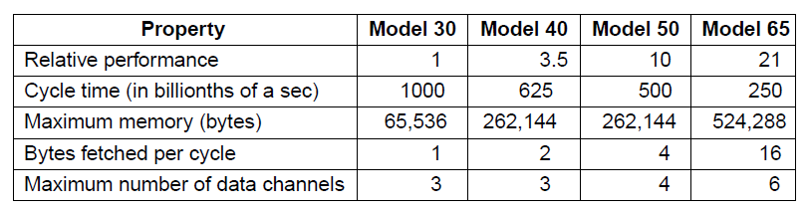
IBM 360
Figure 1-7. The initial offering of the IBM 360 product line.

Slide 17
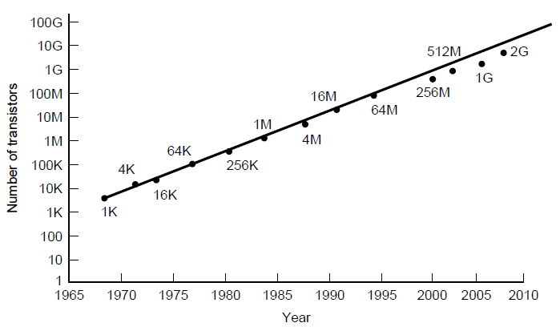
Technological and Economic Forces
Figure 1-8. Moore’s law predicts a 60 percent annual increase in the number of transistors that can be put on a chip. The data points given above and below the line are memory sizes, in bits.

Slide 18
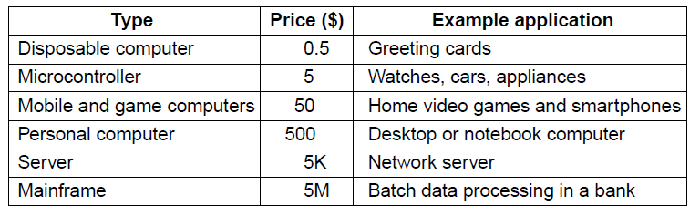
The Computer Spectrum (1)
Figure 1-9. The current spectrum of computers available.
The prices should be taken with a grain
(or better yet, a metric ton) of salt.

Slide 19
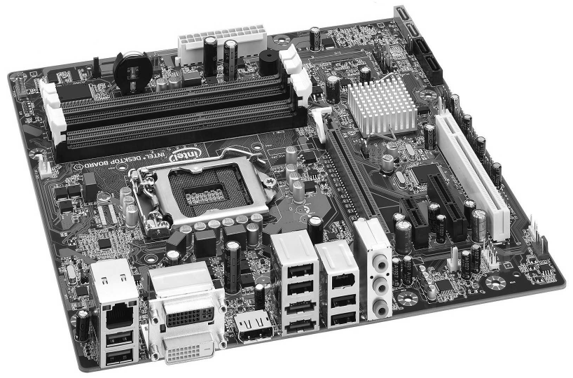
The Computer Spectrum (2)
Figure 1-10. A printed circuit board is at the heart of every personal computer. This one is the Intel DQ67SW board. © 2011 Intel Corporation. Used by permission.

Slide 20
Microcontrollers
Appliances
Communications gear
Computer peripherals
Entertainment devices
Imaging devices
Medical devices
Military weapon systems
Shopping devices
Toys

Slide 21
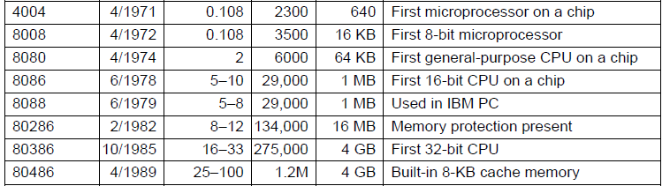
Introduction to the x86 Architecture (1)
. . .
Figure 1-11. Key members of the Intel CPU family. Clock
speeds are measured in MHz (megahertz),
where 1 MHz is 1 million cycles/sec.

Slide 22
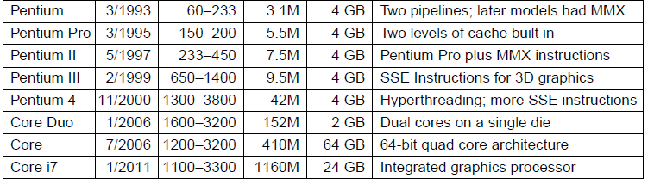
Introduction to the x86 Architecture (2)
Figure 1-11. Key members of the Intel CPU family. Clock
speeds are measured in MHz (megahertz),
where 1 MHz is 1 million cycles/sec.

Slide 23
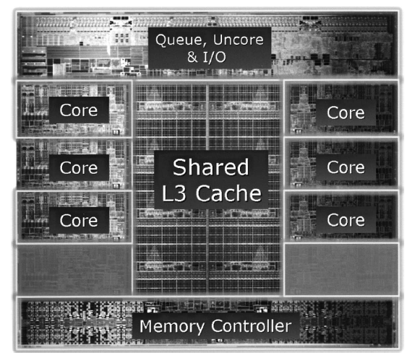
Introduction to the x86 Architecture (3)
Figure 1-12. The Intel Core i7-3960X die. The die is 21 by 21 mm and has 2.27 billion transistors. © 2011 Intel Corporation.
Used by permission.

Slide 24
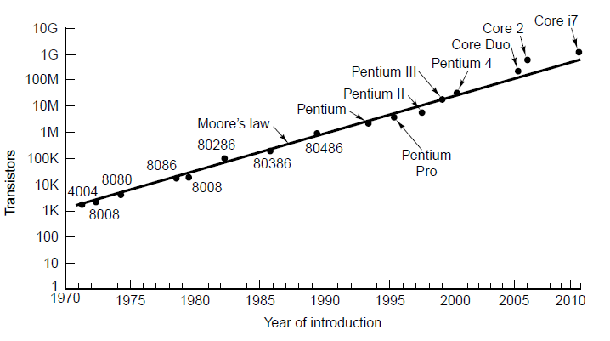
Introduction to the x86 Architecture (4)
Figure 1-13. Moore’s law for (Intel) CPU chips.

Slide 25
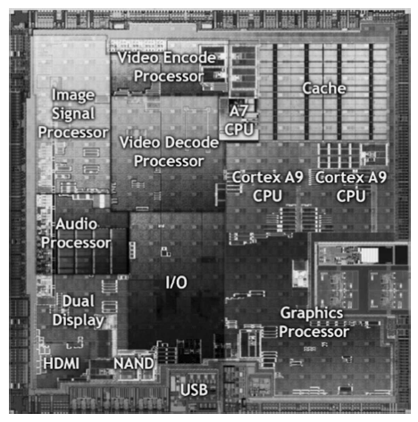
Introduction to the ARM Architecture
Figure 1-14. The Nvidia Tegra 2 system on a chip.
© 2011 Nvidia Corporation. Used by permission.

Slide 26
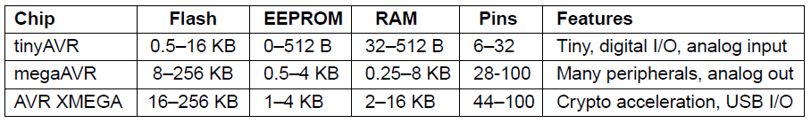
Introduction to the AVR Architecture
Figure 1-15. Microcontroller classes in the AVR family.

Slide 27
Peripherals in the Atmel megaAVR-168
Three timers
Real-time clock with oscillator
Six pulse-width modulation channels
Eight analog-to-digital conversion channels
Universal serial receiver/transmitter
I2C serial interface
Programmable watchdog timer
On-chip analog comparator
Power brown-out detector
Internal programmable clock oscillator

Slide 28
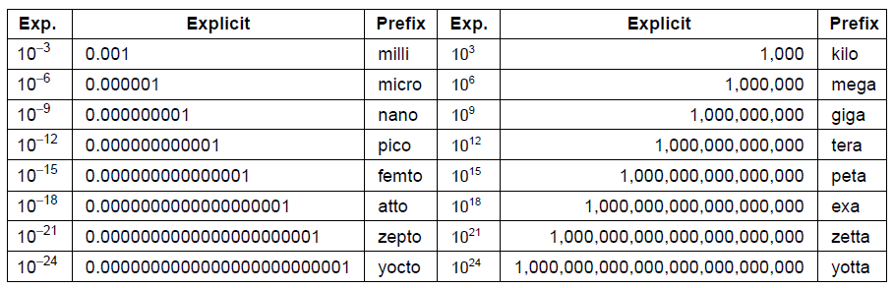
Metric Units
Figure 1-16. The principal metric prefixes.

Slide 29
End
Chapter 1

